Slide 1
ACF vs. PACF

Slide 2
ACF
ACF (Auto-Correlation Function)
The correlation between the VALUES at the current time spot and the VALUES at previous time spots.
Example:
-We measure the correlation between 2 days.
-We can calculate the ACF of, Todays Stock price is correlated with the Stock Price of Yesterday.
-We calculate the ACF of, Todays Stock price is correlated with the Stock Price of (day before yesterday) 2 days back. We show the stock price of the Today days and Stock price - 2 days back.

Slide 3
PACF
PACF (Partial Auto-Correlation Function)
The correlation between observations at two time spots given that we consider both observations are correlated to observations at other time spots. For example, today’s stock price can be correlated to the day before yesterday, and yesterday can also be correlated to the day before yesterday. Then, PACF of yesterday is the “real” correlation between today and yesterday after taking out the influence of the day before yesterday.
-We measure the correlation between 2 days and other days that influence this correlation.
-Todays Stock price is correlated with the Stock Price of Yesterday.
-Todays Stock price is correlated with the Stock Price of (day before yesterday) 2 days back. - But Yesterday Stock price is ALSO correlated with the Stock Price of (day before yesterday). NOW PACF of yesterday is the “real” correlation between today and yesterday, ONLY after we take out the influence of the (day before yesterday).
PACF will help get the real correlation by taking out the influence of other days.

Slide 4
ACF vs. PACF
ACF (Auto-Correlation Function)
The correlation between the observation at the current time spot and the observations at previous time spots.
PACF (Partial Auto-Correlation Function)
The correlation between observations at two time spots given that we consider both observations are correlated to observations at other time spots. For example, today’s stock price can be correlated to the day before yesterday, and yesterday can also be correlated to the day before yesterday. Then, PACF of yesterday is the “real” correlation between today and yesterday after taking out the influence of the day before yesterday.

Slide 5
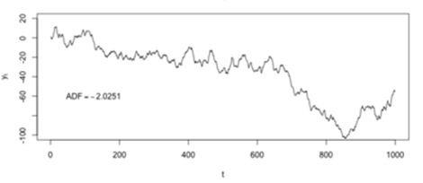
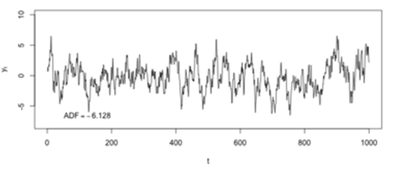
Rules of Using ACF and PACF(1)
Determine if there is an obvious trend in the dataset. If there is, use differencing (i.e., diffing) to “detrend” data. Usually, one-lag differencing is used.
Data with trend
Data after one-lag differencing

Slide 6
Rules of Using ACF and PACF(2)
Use PACF to determine the terms used in the AR model. Only significant terms will be chosen. The number of terms determines the order of the model.
For example, if the PACF of yesterday’s stock price is significant. All other days’ PACFs are not significant. Then, yesterday’s stock price will be used to predict today’s stock price. The AR model is called the first-order autoregression model.
Use ACF to determine the terms used in the MA model.
Choose a model by using PACF and ACF charts together.
Use the “simpler” model if several models could work.

Slide 7
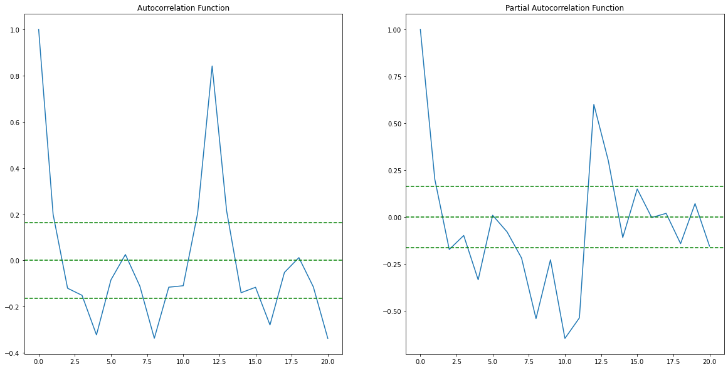

Slide 8
Significance Thresholds
2
2
ACF=2
Significance Thresholds
PACF=2

Slide 9
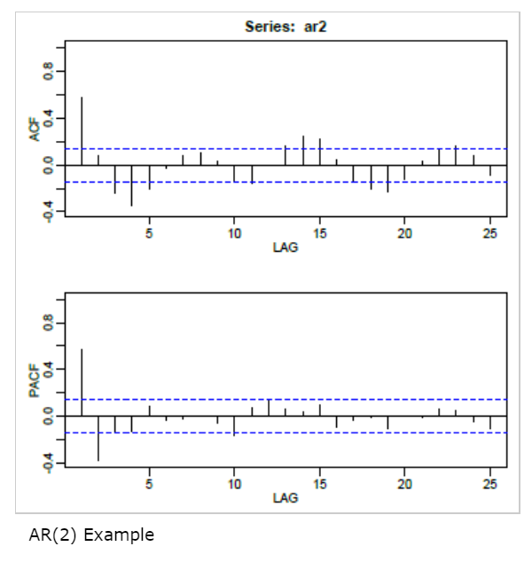
We should check ACF and PACF together
Example 1 , with ACF and PACF chart for a particular dataset
Blue Lines are significance thresholds
Blue Lines are significance thresholds

Slide 10
We should check ACF and PACF together.
In ACF there are several Significant values (lines) that are crossing the threshold.
In PACF there are 2 Significant values (lines) that are crossing the threshold
Here we use AR(2), 2nd order AR model because we need to only yesterday and day before yesterday to predict today value.
Example 1 , with ACF and PACF chart for a particular dataset
Blue Lines are significance thresholds
Blue Lines are significance thresholds

Slide 11
If we use MA model according to the ACT chart the are several lines that are above the significance. So if we have to make the predictions we have to consider several values, which will make our model complicated. So we are considering PACF and hence AR model
Example 1 , with ACF and PACF chart for a particular dataset
Blue Lines are significance thresholds
Blue Lines are significance thresholds

Slide 12
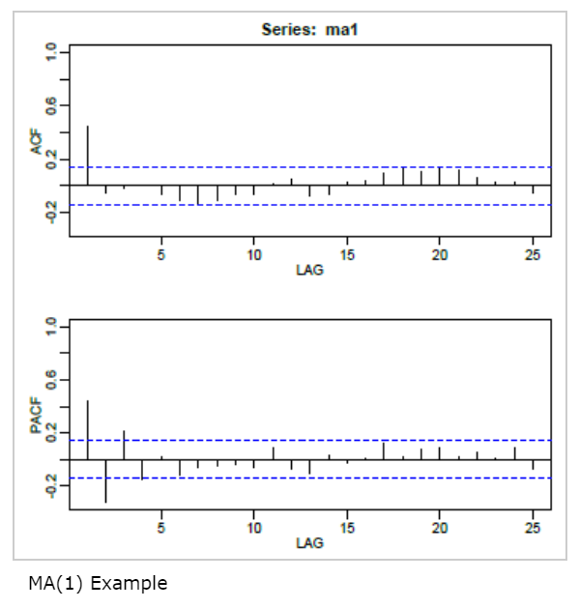
Example 2 , with ACF and PACF chart for a particular dataset
Here we use MA model according to the ACF chart because there is only 1 line above the significance level.
To make the predictions of today, we need to consider only yesterday value.
So we use MA model of the order 1.
PACF has several values above significance so it is not used.

Slide 13
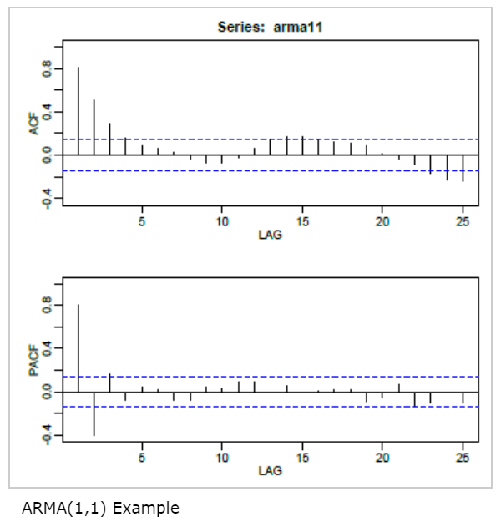
Example 3 , with ACF and PACF chart for a particular dataset
Here ACF has many significance values but PACF has 3 significance values, so we can use 3rd order AR model (PACF).
But we can use another combination, we can use 1st order MA model and 1st AR model as combination because Yesterday’s ACF and PACF values are both significant. ARMA(1,1)

Slide 14
Example 3 , with ACF and PACF chart for a particular dataset
Option1:
Here ACF has many significance values but PACF has 3 significance values, so we can use 3rd order AR model (PACF).
Option2:
But we can use another combination, we can use 1st order MA model and 1st AR model as combination because Yesterday’s ACF and PACF values are both significant. ARMA(1,1)
Here ARIMA, I represents Integrated.

Slide 15
Example 3 , with ACF and PACF chart for a particular dataset
Another version of ARMA is ARIMA.
“I” stands for “Integrated”. It represents the differencing used to handle non-stationary data (i.e., time series with trends).
If the charts on the right are received after one-lag differencing, ARMA(1,1) can be written as ARIMA(1,1,1).
If the charts on right are received after one-lag differencing twice, ARMA(1,1) can be written as ARIMA(1,2,1)
If no difference is applied then ARIMA(1,0,1)

Slide 16
Examples
An alternative way to write ARMA is ARIMA. “I” stands for “Integrated”. It represents the differencing used to handle non-stationary data (i.e., time series with trends). If the charts on the left are received after one-lag differencing, ARMA(1,1) can be written as ARIMA(1,1,1). If the charts on are received after one-lag differencing twice, ARMA(1,1) can be written as ARIMA(1,2,1)

Slide 17
What If …
If all autocorrelations are non-significant, then the series is random (white noise; the ordering matters, but the data are independent and identically distributed.)
If you have taken first differences and all autocorrelations are non-significant, then the series is called a random walk and you are done. (Both the mean and variance are increasing over time.)

